Slide 1
Retaining Water Ice in Regolith at Vacuum - T519
Design Review 4
February 15, 2024

Slide 2





Team Introductions
Katherine Mesa
Kevin Hernandez Lichtl
Astronautical Engineer
Luke Leibkuchler
Systems Engineer
Katherine Mesa
Fluid Test Engineer
Megan Reid
Design Engineer
Trent Walker
Thermal Fluids Engineer

Slide 3
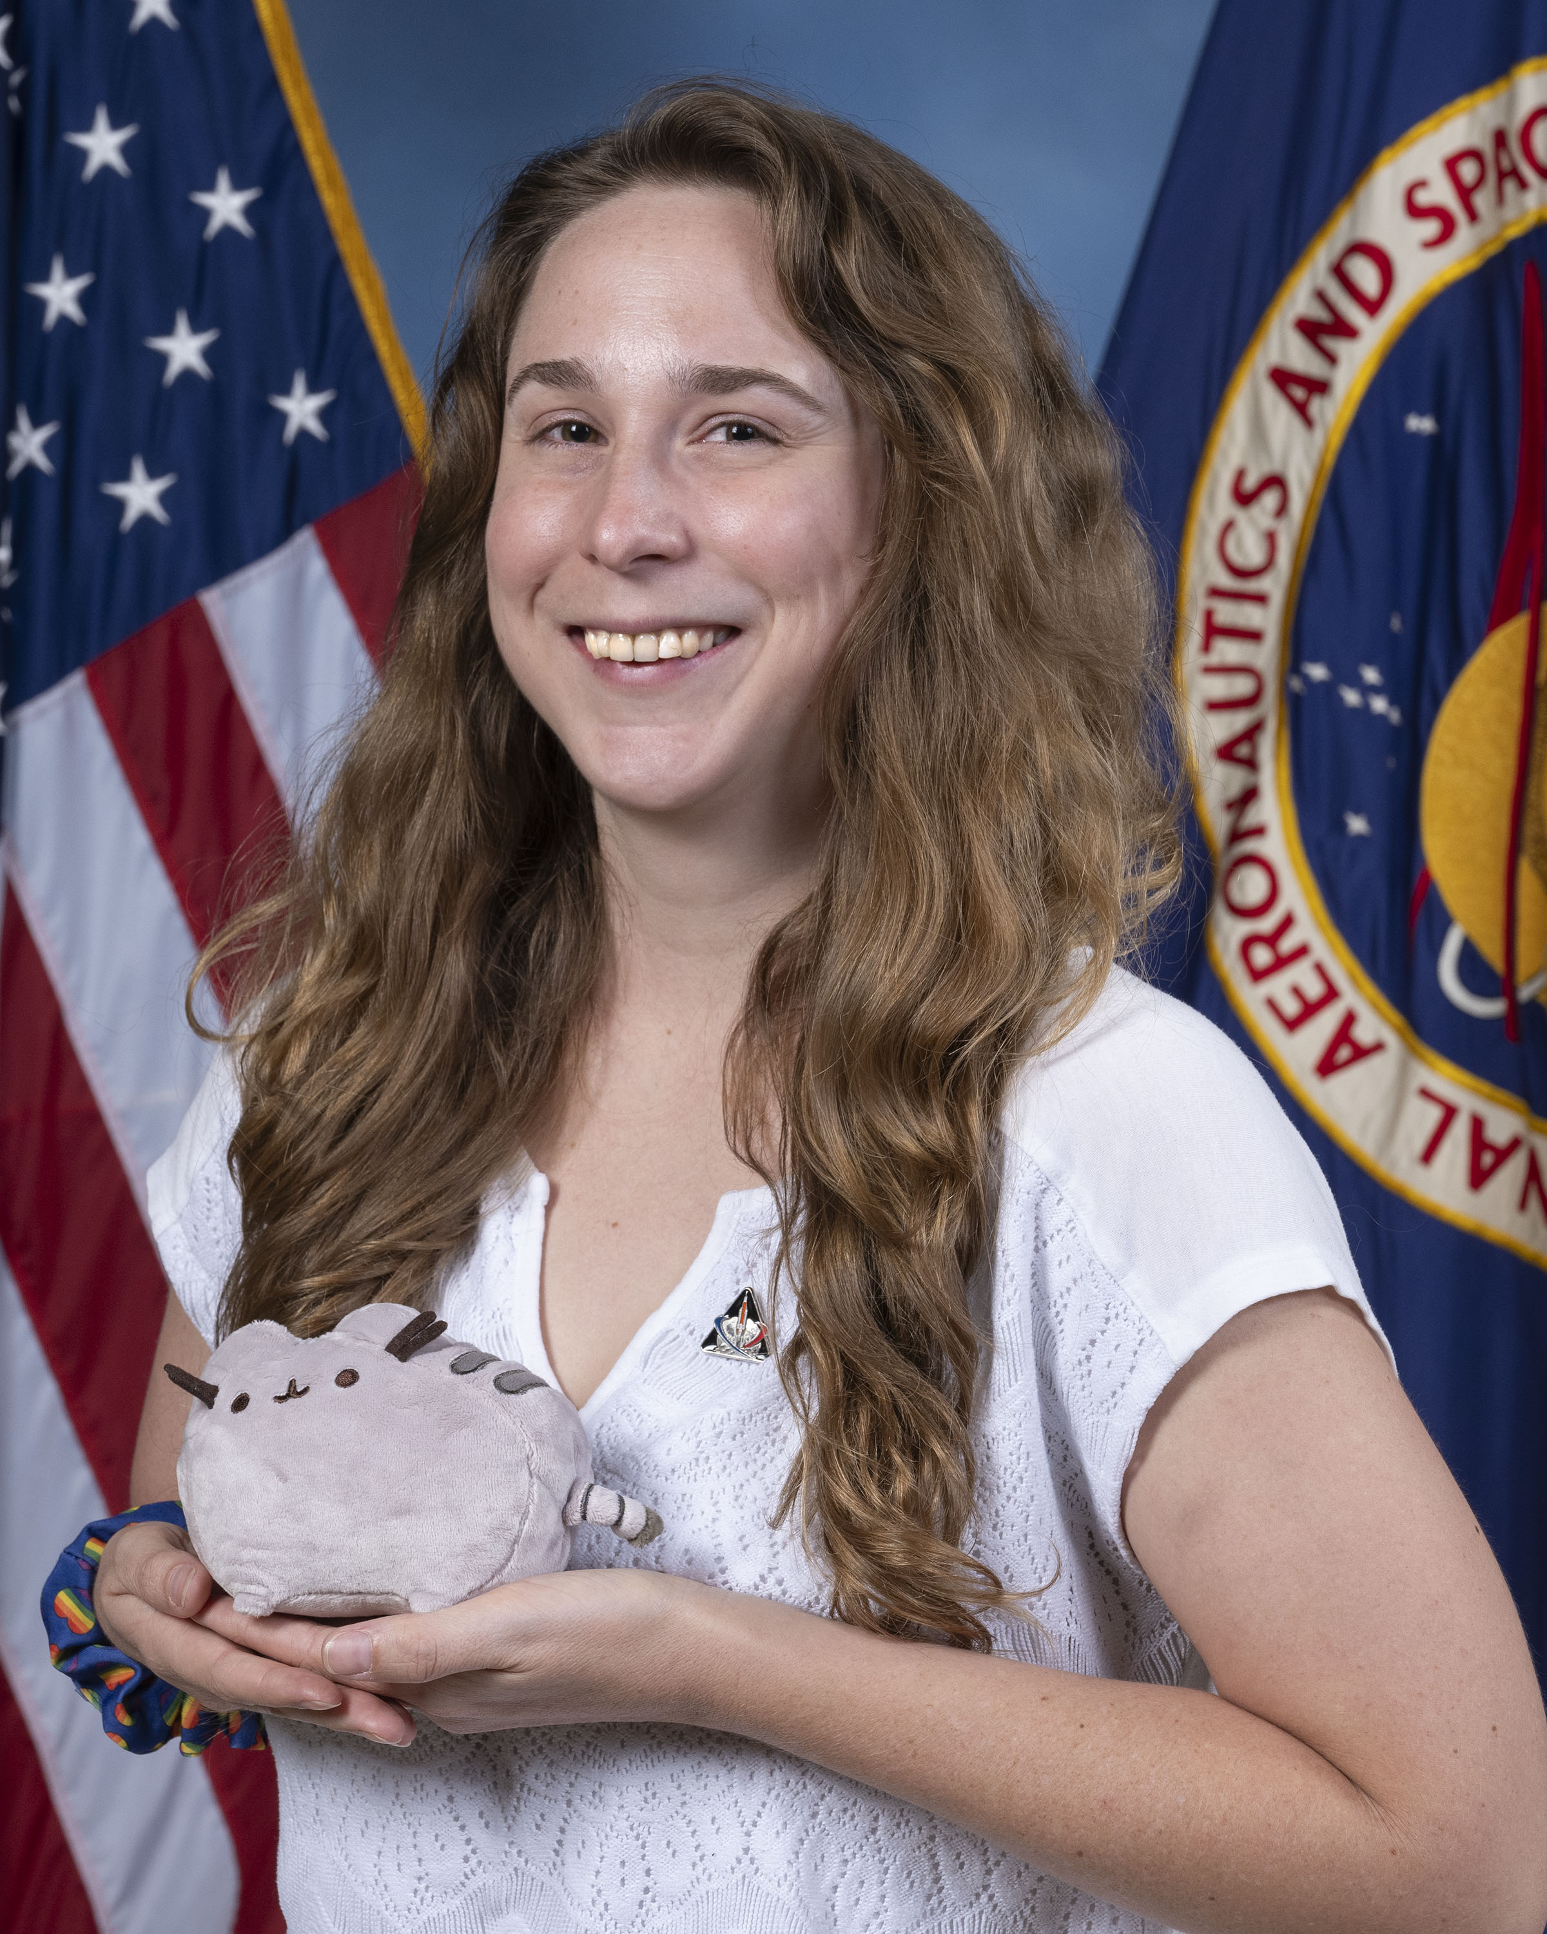


Sponsor and Advisor
Katherine Mesa
Annette Gray
NASA-Marshall Space Flight Center
Mentor
Marvin Barnes
NASA-Marshall Space Flight Center
Sponsor
Dr. Shayne McConomy
FAMU-FSU College of Engineering
Advisor

Slide 4
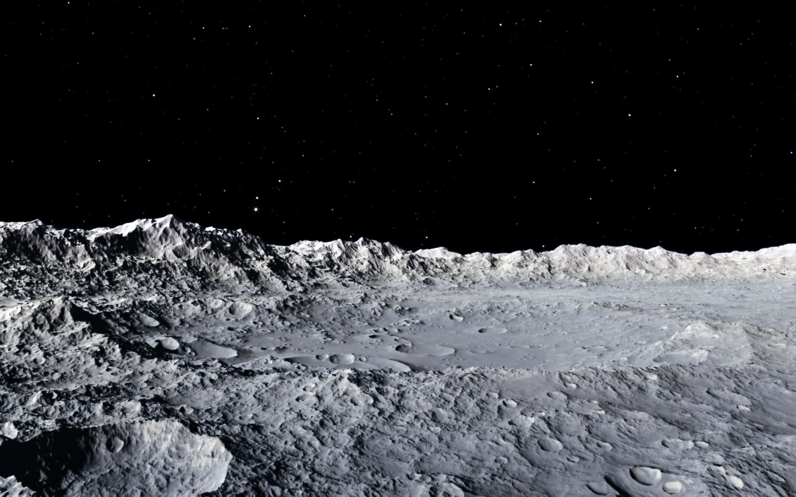
Objective
Katherine Mesa
The objective of this project is to mimic the lunar surface environment in a test fixture​
Notes:
“In order to mimic the lunar surface, we need to understand it first”

Slide 5
Lunar Surface
Katherine Mesa
Water is found as ice in shadowed regions on craters
Atmospheric pressure is equivalent to 2.96x10⁻¹⁵ atm
Surface is made of regolith
Average temperature ranges from 90 K to 380 K
Notes:
To verify performance of structures, mechanisms, and processes, NASA created the PLANET Chamber in Huntsville.
Our job is to simulate lunar surface conditions with a regolith simulant (material that has similar chemical comp. to regolith)

Slide 6
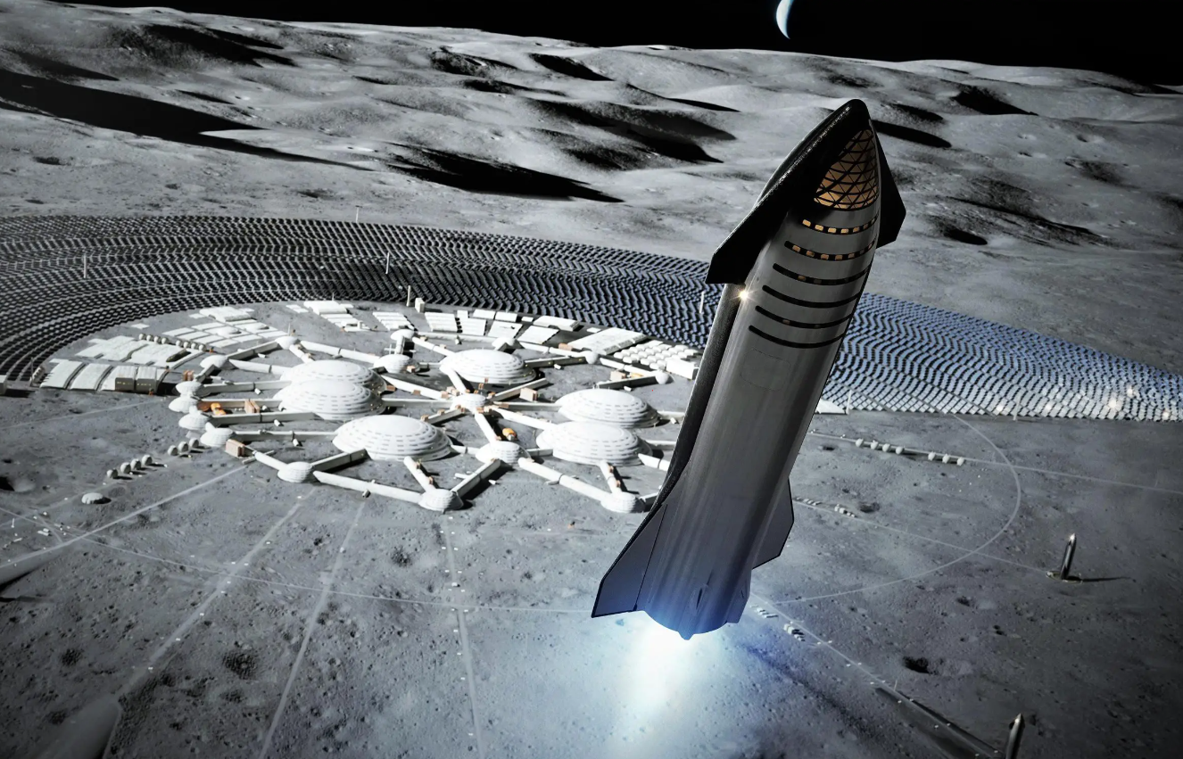
Background
Katherine Mesa
Water ice in craters on the poles
Develop technologies to extract ice
Convert ice into fuel
Lunar Station
Notes:
As we move towards being an interplanetary species
To allow for human travel throughout the solar system, it is believed a lunar colony will be a necessity.
Rather than embarking from Earth, a lunar station will significantly more energy efficient as the moon has a much weaker gravitational force to overcome.
It is believed the moon has water ice hidden in permanently shadowed areas of craters.
Convert H2O --> H2 + O

Slide 7
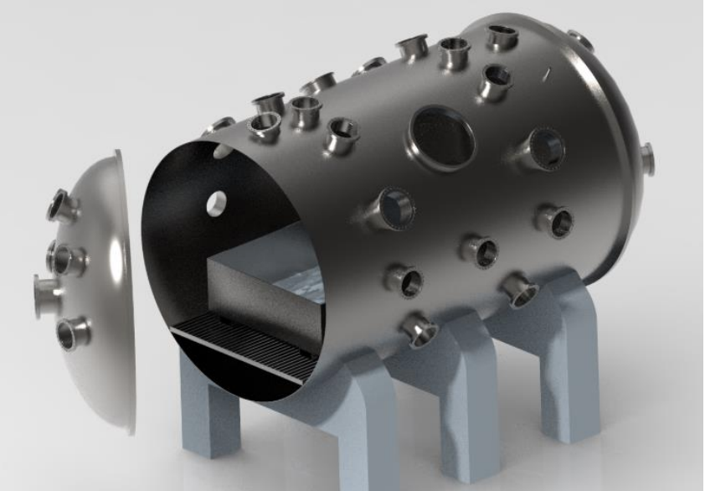
PLANET Chamber
Katherine Mesa
High-fidelity lunar surface environment inside a high-vacuum chamber at NASA
Testing Parameters:
Pressure up to 10⁻⁸ Torr
LN2 plumbing
Notes:
Made of rock chips, mineral fragments, impact and volcanic glasses and a Moon component called “agglutinates”

Slide 8
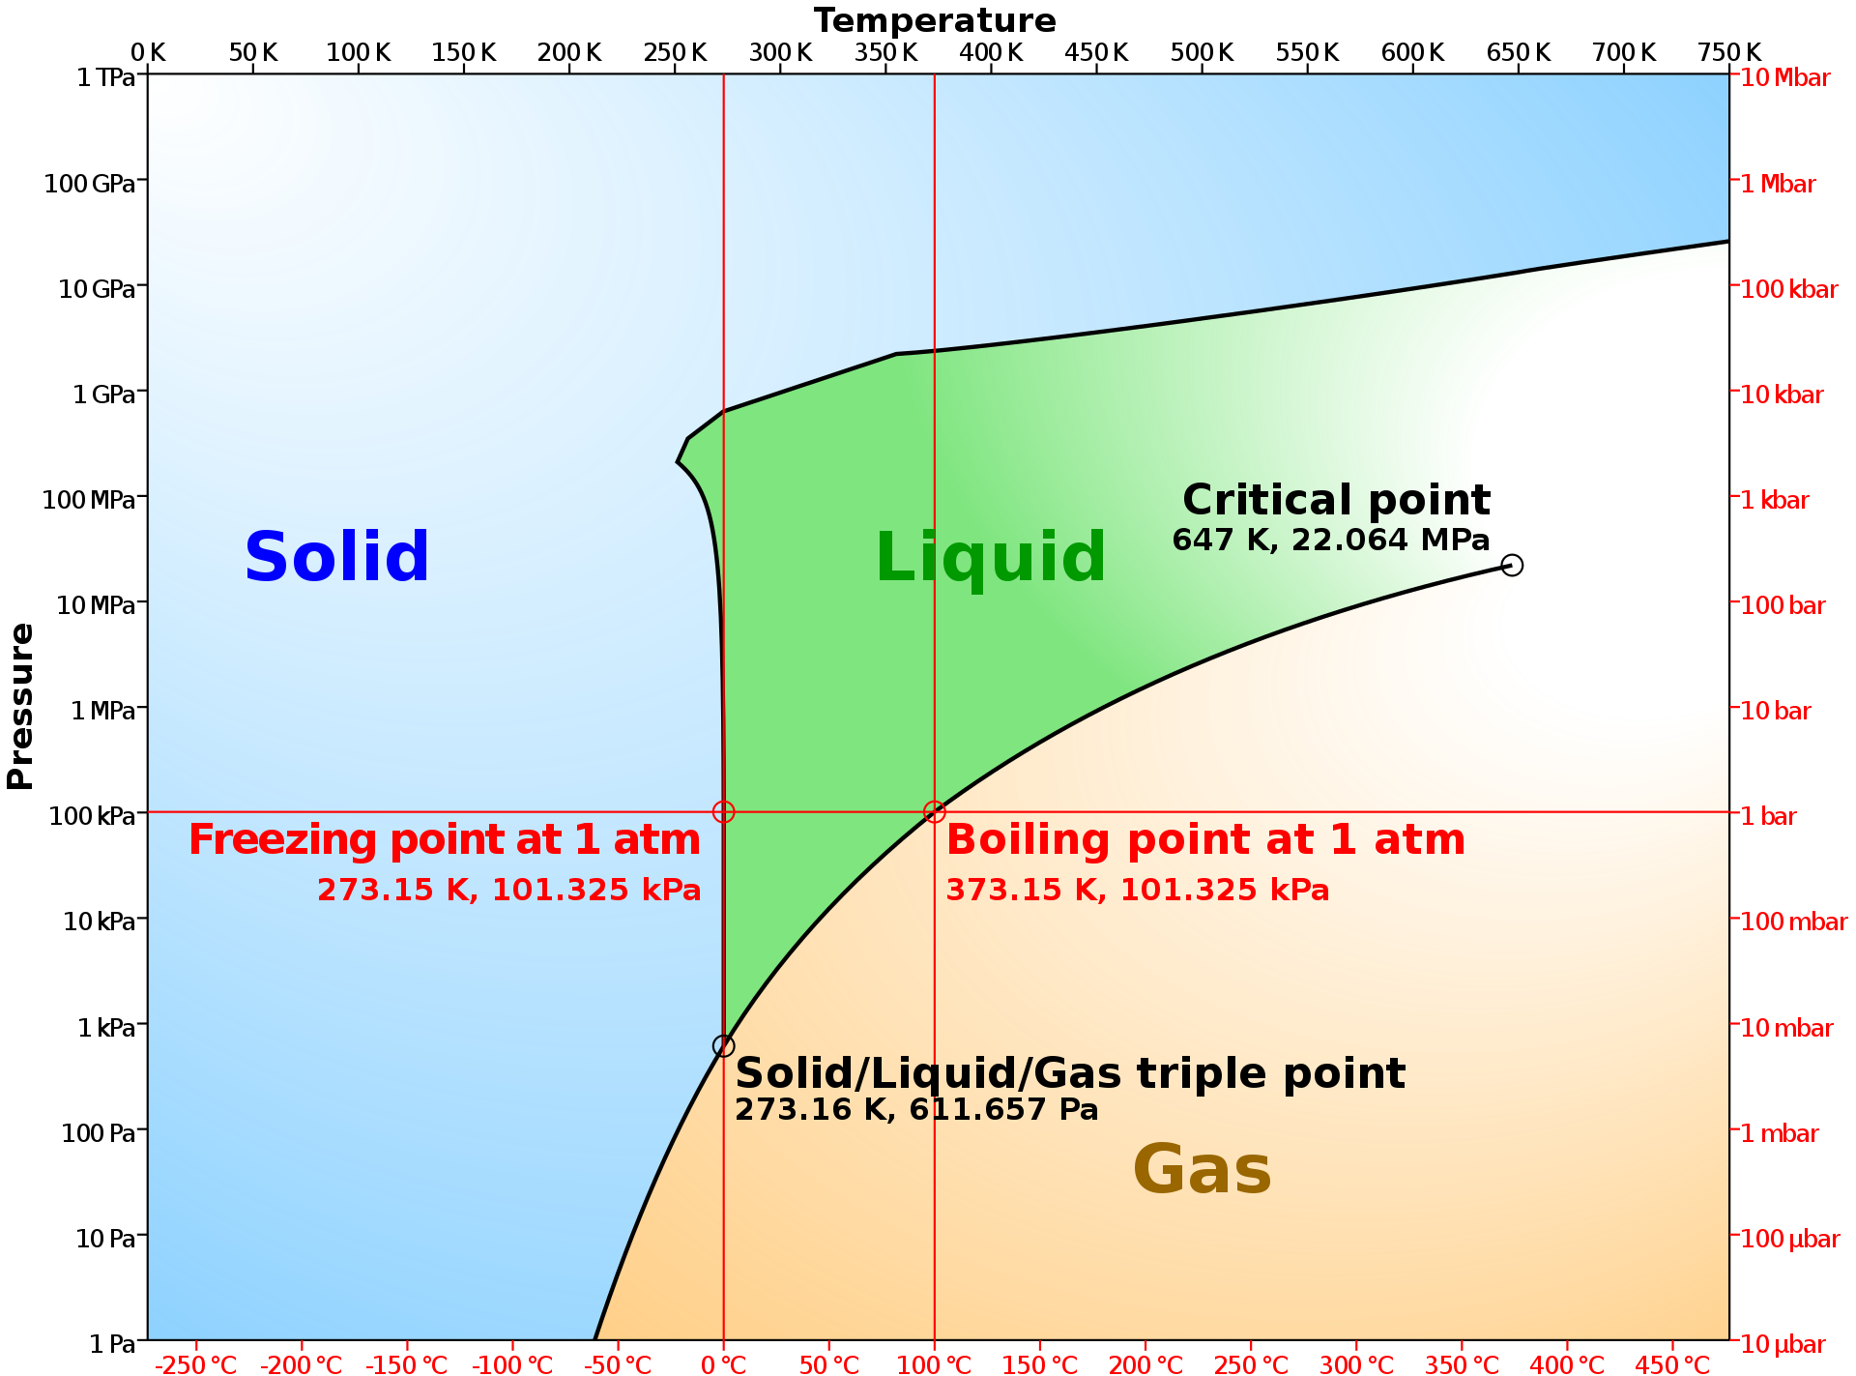
Properties of Water
Katherine Mesa
Notes:
Water Phase Diagram
Lots of energy when saying going down to this pressure without sublimating – main reason we are here

Slide 9
Properties of Water
Katherine Mesa
Notes:
Water Phase Diagram
Lots of energy when saying going down to this pressure without sublimating – main reason we are here

Slide 10
Properties of Water
Katherine Mesa
Notes:
Water Phase Diagram
Lots of energy when saying going down to this pressure without sublimating – main reason we are here

Slide 11
Customer Needs
Katherine Mesa
1
Control water composition and phase within regolith sample
2
Cool regolith sample to cryogenic temperatures
3
Maintain uniform water composition and phase along with temperature
4
Compatible with PLANET chamber apparatus

Slide 12
Functional Decomposition
Katherine Mesa
NASA Cooling Fixture
Thermal
Controls
Structure

Slide 13
Critical Functions
Katherine Mesa
NASA Cooling Fixture
Thermal
Controls
Structure
Pre Pump Down
Post Pump Down
Control water composition
Cool entire mass to cryogenic temperatures
Maintain temperature at high vacuum

Slide 14



Targets and Metrics
Katherine Mesa
Water Composition
Prepare a testing sample containing 95% regolith and 5% water
Cryogenic Temperatures
Cool sample down to 170K – 200K
High Vacuum Pressure
Testing fixture can withstand pressures from 1 atm - 10⁻¹⁰ atm

Slide 15

Concept Generation
Katherine Mesa
100 Concepts
3 High Fidelity
5 Medium Fidelity

Slide 16

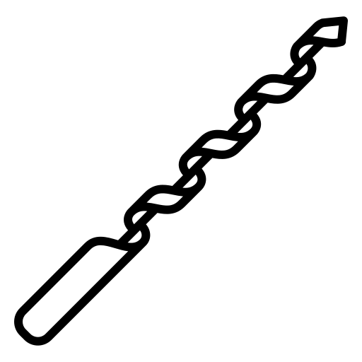

High Fidelity
Katherine Mesa
Cryogenic Jacket
Retractable Augers
1
2
3
Liquid Nitrogen Drip

Slide 17
Concept Selection
Analytical Hierarchy
Katherine Mesa
Notes:
Binary Pairwise, House of Quality, Pugh Chart, AHP

Slide 18
Final Selection
Katherine Mesa
Liquid
Nitrogen Drip
Can Cool Entire Bed Evenly
Ease of Controlling Water Composition
Minimal Impact to PLANET
Operates During Ambient Conditions

Slide 19
Design Changes
Katherine Mesa
Liquid Nitrogen Drip
Main Limitation
Since the Drip Lid must be removed, No Cooling during:
  Experimental setup
  Pump down
  Extraction test in high-vacuum
Notes:
How do we ensure temperature is maintained?

Slide 20

Design Changes
Katherine Mesa
Liquid Nitrogen Drip
Cryogenic Jacket
Notes:
“to target the limitations found with the nitrogen drip, we decided to combine our top two ideas into one: the nitrogen drip and the cryogenic temperature”

Slide 21
Design Changes
Katherine Mesa
Liquid Nitrogen Drip
Cryogenic Jacket
Maximize Cooling
Notes:
“to target the limitations found with the nitrogen drip, we decided to combine our top two ideas into one: the nitrogen drip and the cryogenic temperature”

Slide 22
Design Changes
Katherine Mesa
Liquid Nitrogen Drip
Cryogenic Jacket
Maximize Cooling
Maintain Temperature
Notes:
“to target the limitations found with the nitrogen drip, we decided to combine our top two ideas into one: the nitrogen drip and the cryogenic temperature”

Slide 23
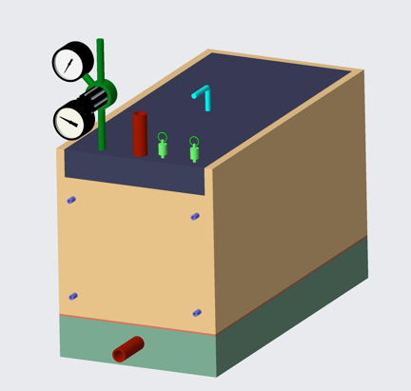
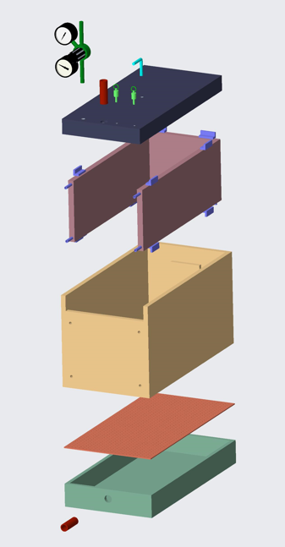
Current Design: Assembly
Megan Reid
Lid
Jacket
Shell
Grate
Bottom

Slide 24

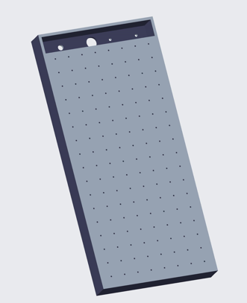
Current Design: Lid
Megan Reid
Drilled Holes
LN2 Inlet
Top View
Bottom View

Slide 25
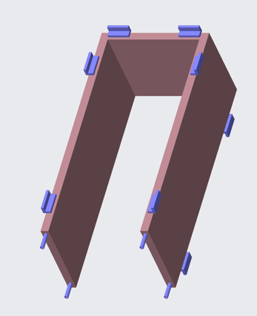
Current Design: Jacket
Megan Reid
Attachment Points
GN2 Outlets
LN2 Inlets

Slide 26

Current Design: Grate
Megan Reid
Perforated Sheet

Slide 27

Current Design: Bottom
Megan Reid
GN2 Outlet
Notes:
Sample is mixed and you’re ready to cool it down.

Slide 28


Operating Procedure – Pre-Cool
Megan Reid
1
Weigh Out Needed Regolith and Water

Slide 29
Operating Procedure – Pre-Cool
Megan Reid
1
Weigh Out Needed Regolith and Water
+
=
2
Combine Regolith and Water

Slide 30
Operating Procedure – Pre-Cool
Megan Reid
1
Weigh Out Needed Regolith and Water
2
Combine Regolith and Water
3
Add Sample to Box

Slide 31
Operating Procedure – Pre-Cool
Megan Reid
1
Weigh Out Needed Regolith and Water
2
Combine Regolith and Water
3
Add Sample to Box

Slide 32
Operating Procedure – Pre-Cool
Megan Reid
Dry Air
1
Weigh Out Needed Regolith and Water
LN2 Lid
2
Combine Regolith and Water
3
Add Sample to Box
4
Purge System with Dry Air

Slide 33
Operating Procedure – Cool Down
Megan Reid
Sample is ready. Assume at 295K
A
LN2 Jacket Priming
Nitrogen Jacket
PLANET Chamber
*Not pressurized

Slide 34
Operating Procedure – Cool Down
Megan Reid
Sample is ready. Assume at 295K
A
LN2 Jacket Priming
GN2 Exit
PLANET Chamber
*Not pressurized
LN2

Slide 35
Operating Procedure – Cool Down
Megan Reid
Sample is ready. Assume at 295K
A
LN2 Jacket Priming
GN2 Exit
B
LN2 Jacket & Drip Lid
GN2 Exit
PLANET Chamber
*Not pressurized
LN2 Jacket Still Connected
LN2
LN2

Slide 36
Operating Procedure – Post Cool
Megan Reid
170K-200K Reached
LN2 Jacket Still Connected

Slide 37
Operating Procedure – Post Cool
Megan Reid
170K-200K Reached
1
Remove LN2 Lid
LN2 Jacket Still Connected

Slide 38

Operating Procedure – Post Cool
Megan Reid
170K-200K Reached
1
Remove LN2 Lid
2
Experimental Setup
LN2 Jacket Still Connected

Slide 39
Operating Procedure – Post Cool
Megan Reid
170K-200K Reached
1
Remove LN2 Lid
2
Experimental Setup
3
Ready for Vacuum
LN2 Jacket Still Connected

Slide 40
Operating Procedure – Post Cool
Megan Reid
170K-200K Reached
1
Remove LN2 Lid
2
Experimental Setup
3
Ready for Vacuum
4
LN2 Jacket Still Connected
Pump Down

Slide 41
Bill of Materials
Megan Reid

Slide 42
Challenges
Megan Reid
1
2
3
4
Cooling
Impermeable layers of ice due to rapid freezing
Temperature reaching the core of the sample

Slide 43
Challenges
Megan Reid
1
2
Liquid Nitrogen
3
4
Cooling
Impermeable layers of ice due to rapid freezing
Temperature reaching the core of the sample
LN2 boil off effects
Expansion rate from LN2 to GN2
Acquiring LN2 for testing

Slide 44
Challenges
Megan Reid
1
2
Liquid Nitrogen
3
Safety Valve
4
Cooling
Impermeable layers of ice due to rapid freezing
Temperature reaching the core of the sample
LN2 boil off effects
Expansion rate from LN2 to GN2
Acquiring LN2 for testing
Optimal location for pressure safety valve

Slide 45
Challenges
Megan Reid
1
2
Liquid Nitrogen
3
Safety Valve
4
Weight
Cooling
Impermeable layers of ice due to rapid freezing
Temperature reaching the core of the sample
LN2 boil off effects
Expansion rate from LN2 to GN2
Acquiring LN2 for testing
Optimal location for pressure safety valve
Ease of transporting
Removing the LN2 lid

Slide 46

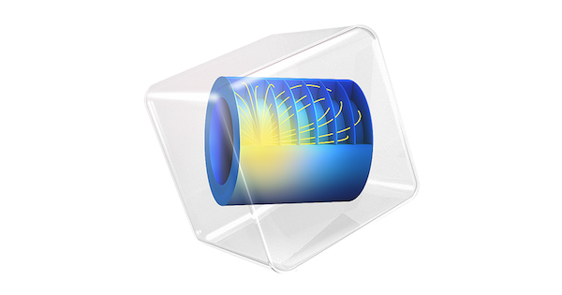



Future Work
Megan Reid
Procurement
CAD and Fabrication
Programming
Order remaining materials
Begin controls programming and LabView
Finalize CAD and begin fabrication process
Continue working on COMSOL model
Locate a testing facility to run initial test
COMSOL Model
Testing Facility Details
Meet with advising team

Slide 47

Thank You!
Notes:
Targets and Metrics
Concept Generation and Selection
Prototypes
Biweekly Sponsor Meetings
Risk Assessment
Bill of Materials
Spring Project Plan

Slide 48
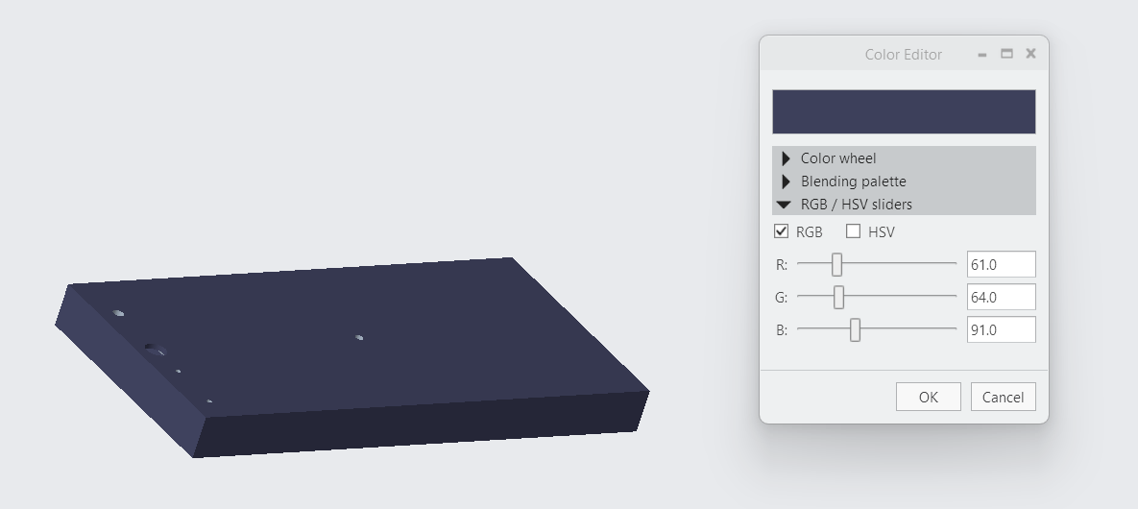

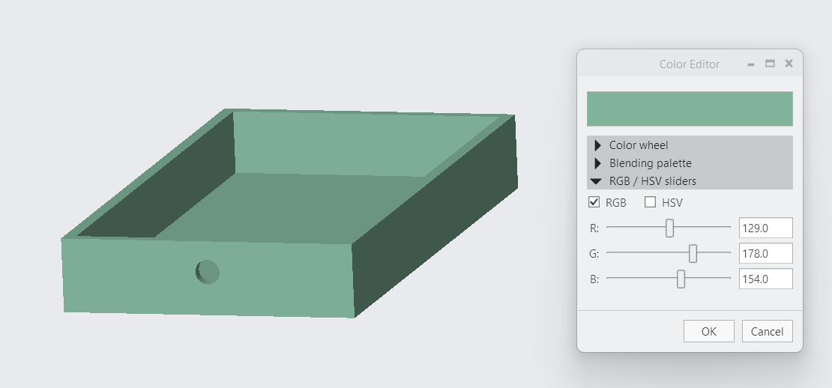
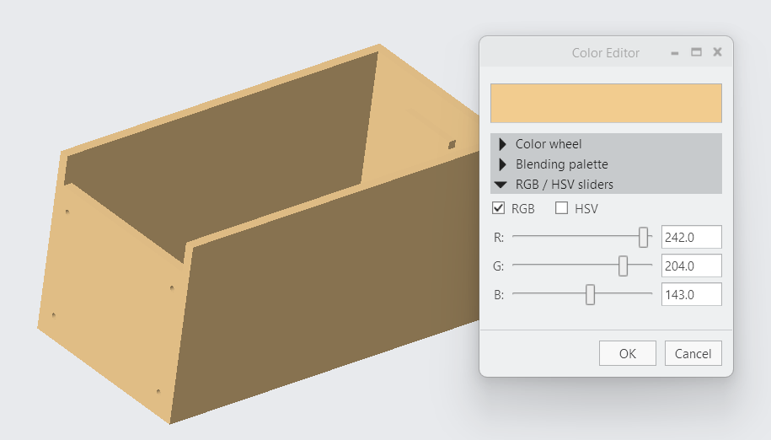
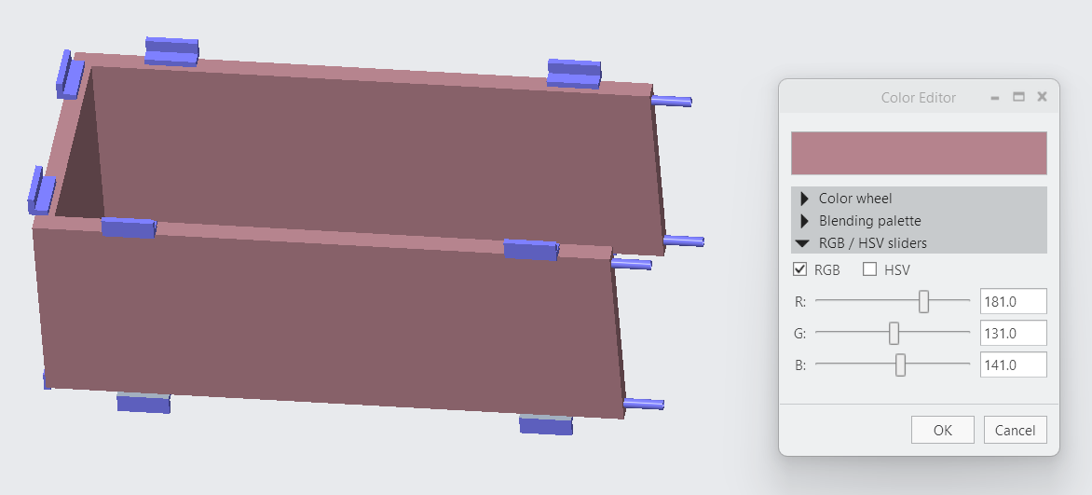

Slide 49
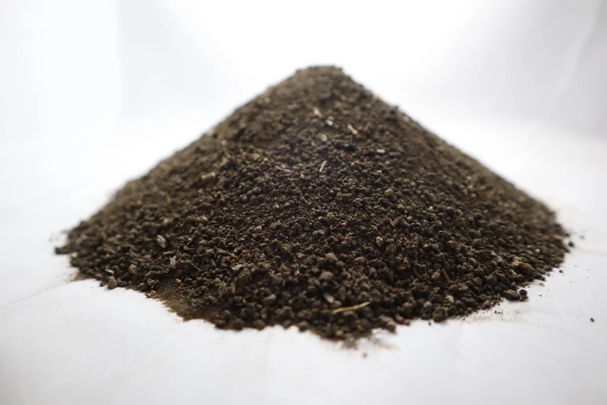
Background
Katherine Mesa
Regolith is the layer of rock and dust on the moon
Highly insulative
Notes:
Made of rock chips, mineral fragments, impact and volcanic glasses and a Moon component called “agglutinates”

Slide 50
Background
Katherine Mesa
Regolith is the layer of rock and dust on the moon
Highly insulative
PLANET Chamber
High-fidelity lunar surface environment inside a high-vacuum chamber at NASA
Notes:
Made of rock chips, mineral fragments, impact and volcanic glasses and a Moon component called “agglutinates”

Slide 51
Customer Needs
Katherine Mesa
1
Control water composition and phase within regolith sample
2
Cool regolith sample to cryogenic temperatures
3
Maintain uniform water composition and phase along with temperature
4
Compatible with PLANET chamber apparatus

Slide 52




Concept Selection
Trent Walker
Binary Pairwise
House of Quality
Pugh Chart
Analytical Hierarchy

Slide 53
Katherine Mesa
Regolith Fixture
Notes:
Made of rock chips, mineral fragments, impact and volcanic glasses and a Moon component called “agglutinates”

Slide 54
Katherine Mesa
Regolith Fixture
Notes:
Made of rock chips, mineral fragments, impact and volcanic glasses and a Moon component called “agglutinates”

Slide 55
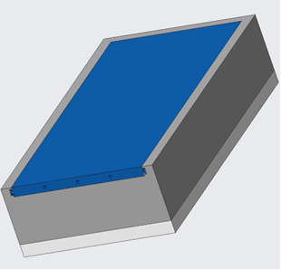
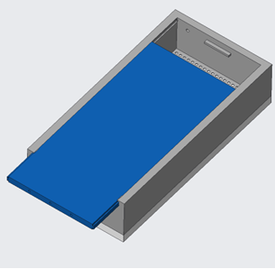
Preliminary Drip Lid CAD
Kevin Hernandez Lichtl
Top View - Closed
Top View - Open

Slide 56
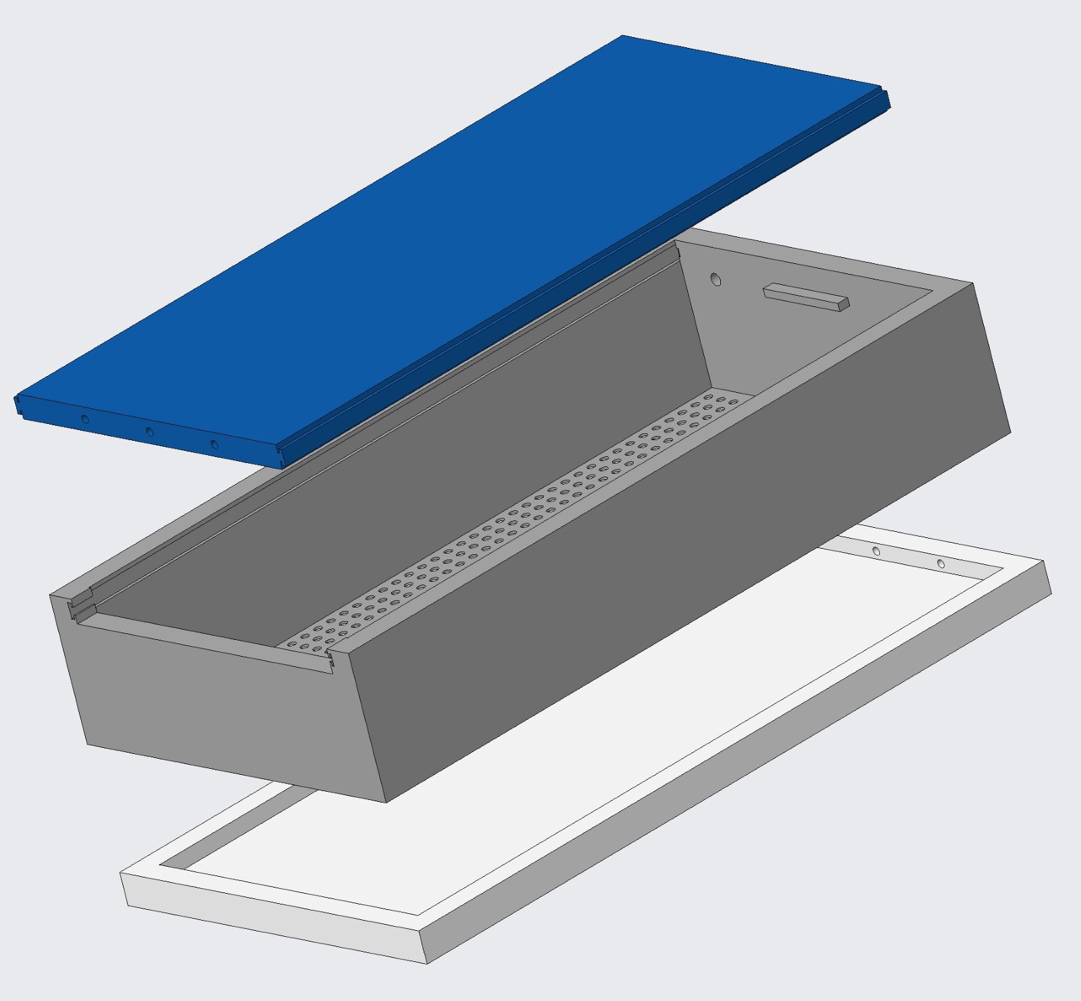
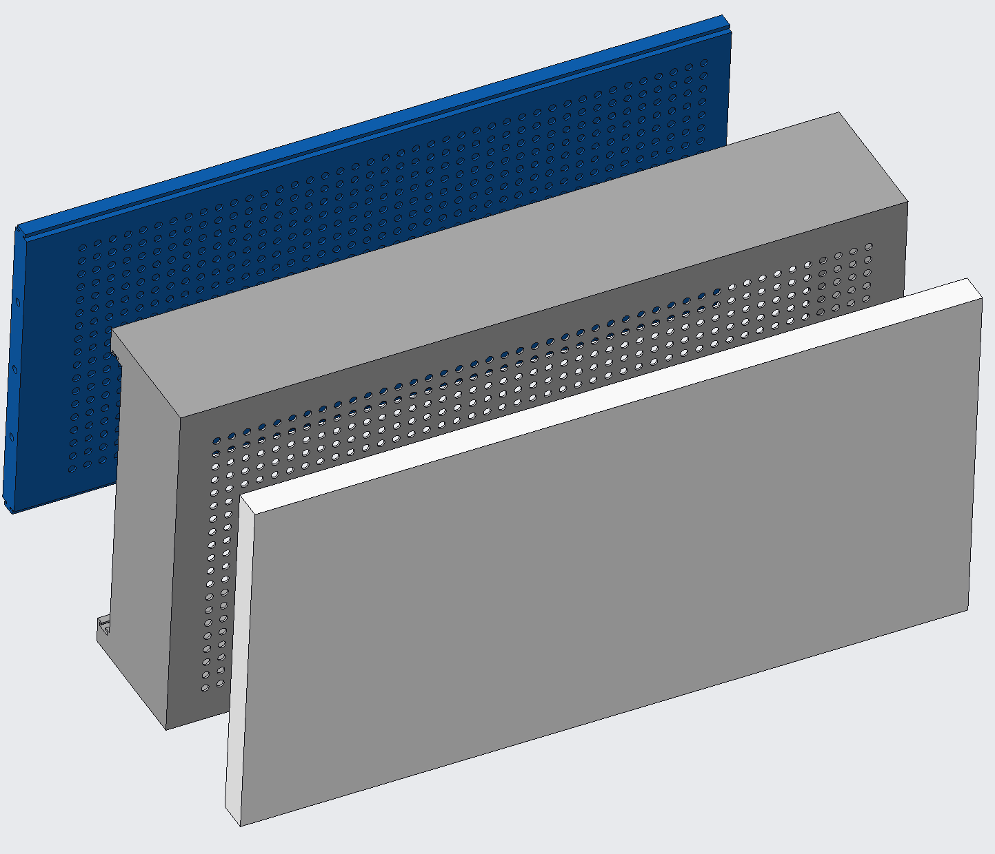
Preliminary Drip Lid CAD
Kevin Hernandez Lichtl
Side View - Exploded
Bottom View - Exploded

Slide 57
Current Design: Assembly
Megan Reid

Slide 58
Current Design: Lid
Megan Reid
LN2 Inlet
Top View
Bottom View

Slide 59
Current Design: Jacket
Megan Reid

Slide 60
Current Design: Grate
Megan Reid

Slide 61
Current Design: Bottom
Megan Reid
Notes:
Sample is mixed and you’re ready to cool it down.

Slide 62
Katherine Mesa
Our Job
Simulate lunar surface conditions with a regolith simulant
Cryogenic Temperature
Water Composition and Phase
Compatible with PLANET chamber
Notes:
Made of rock chips, mineral fragments, impact and volcanic glasses and a Moon component called “agglutinates”

Slide 63

Liquid Nitrogen Drip
Kevin Hernandez Lichtl
LN2 Liquid
LN2 Liquid Drip
Regolith Bed
1
2
3

Slide 64
Liquid Nitrogen Drip
Kevin Hernandez Lichtl
LN2 Liquid
LN2 Liquid Drip
LN2 Gas Exit
Pump
Regolith Bed
1
2
3

Slide 65

Liquid Nitrogen Drip
Kevin Hernandez Lichtl
LN2 Liquid
LN2 Liquid Drip
LN2 Gas Exit
Pump
Regolith Bed
Bottom Grate
LN2 Gas Reentry
1
2
3

Slide 66
Liquid Nitrogen Drip
Kevin Hernandez Lichtl
LN2 Liquid
LN2 Liquid Drip
LN2 Gas Exit
Pump
Regolith Bed
LN2 Gas Exit
Bottom Grate
LN2 Gas Reentry
1
2
3

Slide 67
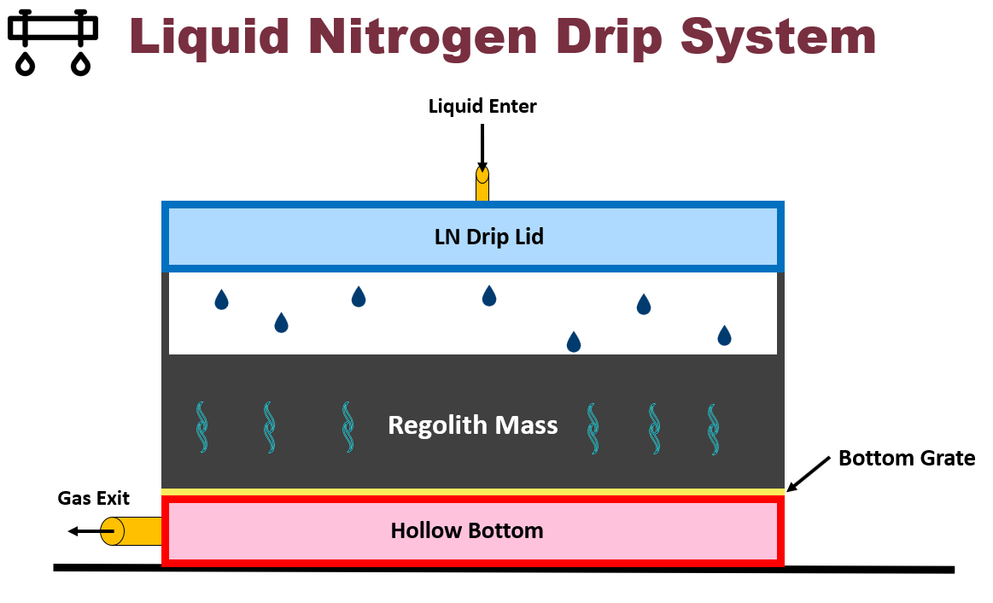
Kevin Hernandez Lichtl

Slide 68
Testing and Validation
Megan Reid
Water Composition
Confirm formula for calculating water needed for amount of regolith.
Cooling
Is cooling more efficient with step A or step B of cool down?
Sensors
Are the sensors correctly placed to read temperature distribution?
Tubing
Are there any N2 gas leaks once testing fixture is connected?
How quick does the sample regain heat?

Slide 69
Testing and Validation
Megan Reid
1
2
Cooling
3
Tubing
4
Sensors
Water Composition
Confirmed formula for calculating water needed for amount of regolith.
Experiment is created for comparing cool down options.

Slide 70
Operating Procedure – Post Cool
Megan Reid
170K Reached

Slide 71
Operating Procedure – Post Cool
Megan Reid
170K Reached
1
Remove N2 Lid

Slide 72
Operating Procedure – Post Cool
Megan Reid
170K Reached
1
Remove N2 Lid
2
Add Styrofoam Lid

Slide 73
Operating Procedure – Post Cool
Megan Reid
170K Reached
1
Remove N2 Lid
2
Add Styrofoam Lid
3
Ready for Vacuum
PLANET Chamber
Notes:
***remove Styrofoam lid, transport to chamber, ready for vacuum

Slide 74
Operating Procedure – Cool Down
Megan Reid
Sample is ready. Assume at 295K

Slide 75
Operating Procedure – Cool Down
Megan Reid
Sample is ready. Assume at 295K
A
One Step – LN2 Primary
LN2 Lid
PLANET Chamber
*Not pressurized

Slide 76
Operating Procedure – Cool Down
Megan Reid
Sample is ready. Assume at 295K
A
One Step – LN2 Primary
LN2 Lid
PLANET Chamber
*Not pressurized

Slide 77
Operating Procedure – Cool Down
Megan Reid
Sample is ready. Assume at 295K
A
One Step – LN2 Primary
LN2 Lid
LN2
PLANET Chamber
*Not pressurized

Slide 78
Operating Procedure – Cool Down
Megan Reid
Sample is ready. Assume at 295K
A
One Step – LN2 Primary
B
Two Step – Freezer & LN2
Freezer
LN2 Lid
LN2
PLANET Chamber
*Not pressurized

Slide 79
Operating Procedure – Cool Down
Megan Reid
Sample is ready. Assume at 295K
A
One Step – LN2 Primary
B
Two Step – Freezer & LN2
Freezer
Transfer at 260K
LN2 Lid
LN2
PLANET Chamber
*Not pressurized

Slide 80
Operating Procedure – Cool Down
Megan Reid
Sample is ready. Assume at 295K
A
One Step – LN2 Primary
B
Two Step – Freezer & LN2
Freezer
Transfer at 260K
PLANET Chamber
*Not pressurized
LN2 Lid
LN2 Lid
LN2
PLANET Chamber
*Not pressurized
LN2

Slide 81
Operating Procedure – Post Cool
Megan Reid
170K-200K Reached
1
Remove N2 Lid
2.5
Add Styrofoam Lid
LN2 Jacket Still Connected

Slide 82
PLANET Chamber
Planetary, Lunar, and Asteroid Natural Environments Testbed
Megan Reid
A high-fidelity lunar surface environment inside a well equipped high-vacuum chamber at NASA’s Marshall Space Flight Center

Slide 83
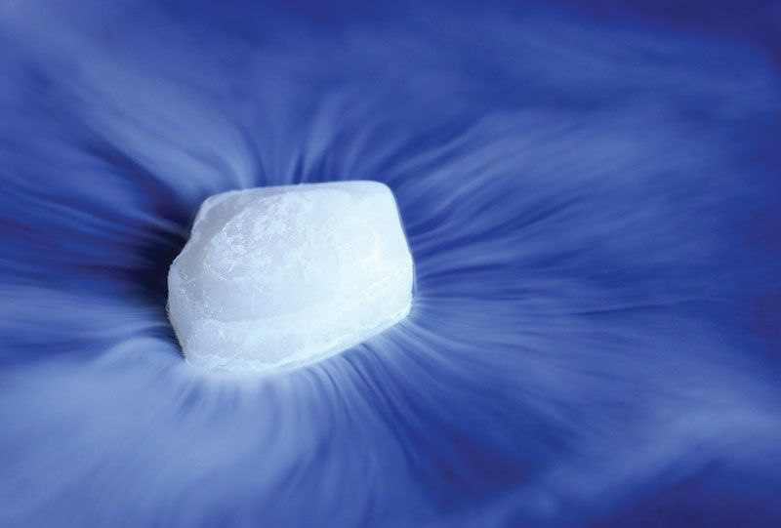
Current Issue
Megan Reid
Water ice in regolith will sublimate to gas if not cold enough before high vacuum
Water vapor condenses out of air when cooled before vacuum
Notes:
Water VAPOR, condenses out of air when cooled before vacuum...
affecting regolith-water content

Slide 84




Megan Reid
Key Goals
Thermal Maintenance
Regolith
PLANET
Chamber
High Vacuum
Notes:
Cool regolith simulant bed before and during high vacuum (10^-7 Torr)
Regolith needs to be cooled to a low enough temperature before depressurization so that water ice doesn’t sublimate
Needs to fit within the NASA PLANET Chamber

Slide 85
Properties of Water
Megan Reid

Slide 86
Customer Needs
Katherine Mesa
Water
Phase
Uniform
Properties
Monitor
Properties
PLANET
Chamber
Pressure
Maintain water in the solid phase
Water will be in the regolith

Slide 87
Customer Needs
Katherine Mesa
Water
Phase
Uniform
Properties
Monitor
Properties
PLANET
Chamber
Pressure
Maintain water in the solid phase
Water will be in the regolith
Operates in atmospheric to high vacuum pressure
Mimics space environment

Slide 88
Customer Needs
Katherine Mesa
Water
Phase
Uniform
Properties
Monitor
Properties
PLANET
Chamber
Pressure
Maintain water in the solid phase
Water will be in the regolith
Operates in atmospheric to high vacuum pressure
Mimics space environment
Reaches desired moisture, pressure, and temperature in regolith

Slide 89
Customer Needs
Katherine Mesa
Water
Phase
Uniform
Properties
Monitor
Properties
PLANET
Chamber
Pressure
Maintain water in the solid phase
Water will be in the regolith
Operates in atmospheric to high vacuum pressure
Mimics space environment
Reaches desired moisture, pressure, and temperature in regolith
Ability to monitor moisture, pressure, and temperature in regolith

Slide 90
Customer Needs
Katherine Mesa
Water
Phase
Uniform
Properties
Monitor
Properties
PLANET
Chamber
Pressure
Maintain water in the solid phase
Water will be in the regolith
Operates in atmospheric to high vacuum pressure
Mimics space environment
Reaches desired moisture, pressure, and temperature in regolith
Ability to monitor moisture, pressure, and temperature in regolith
Fits into and is compatible with the PLANET Chamber

Slide 91
Customer Needs
Luke Leibkuchler
Maintain Water at Ice in Regolith
Operate in Atmospheric to High Vacuum Pressure
Uniform Moisture, Pressure, and Temperature in Regolith
Ability to Monitor Properties
Operate in PLANET Chamber

Slide 92
Customer Needs
Luke Leibkuchler
Maintain Water at Ice in Regolith
Operate in Atmospheric to High Vacuum Pressure
Uniform Moisture, Pressure, and Temperature in Regolith
Ability to Monitor Properties
Operate in PLANET Chamber

Slide 93
Customer Needs
Luke Leibkuchler
Maintain Water at Ice in Regolith
Operate in Atmospheric to High Vacuum Pressure
Uniform Moisture, Pressure, and Temperature in Regolith
Ability to Monitor Properties
Operate in PLANET Chamber

Slide 94
Customer Needs
Luke Leibkuchler
Maintain Water at Ice in Regolith
Operate in Atmospheric to High Vacuum Pressure
Uniform Moisture, Pressure, and Temperature in Regolith
Ability to Monitor Properties
Operate in PLANET Chamber

Slide 95
Customer Needs
Luke Leibkuchler
Maintain Water at Ice in Regolith
Operate in Atmospheric to High Vacuum Pressure
Uniform Moisture, Pressure, and Temperature in Regolith
Ability to Monitor Properties
Operate in PLANET Chamber

Slide 96
Customer Needs
Luke Leibkuchler
Maintain Water at Ice in Regolith
Operate in Atmospheric to High Vacuum Pressure
Uniform Moisture, Pressure, and Temperature in Regolith
Ability to Monitor Properties
Operate in PLANET Chamber

Slide 97
Properties of Water
Katherine Mesa
Notes:
Lots of energy when saying going down to this pressure without sublimating – main reason we are here

Slide 98
Properties of Water
Katherine Mesa
Notes:
Lots of energy when saying going down to this pressure without sublimating – main reason we are here

Slide 99




Markets & Stakeholders
Megan Reid
NASA
MagLab
Private Aerospace Companies
FAMU-FSU
Notes:
Primary:
NASA
Secondary:
SpaceX, Boeing, or Blue Origin
Private aerospace companies developing extraction and excavation technologies

Slide 100
Customer Needs
Maintain Water at Ice
Operate in Atmospheric to High Vacuum Pressure
Uniform Moisture, Pressure, and Temperature in Regolith
Ability to Monitor Properties
Operate in PLANET Chamber

Slide 101
Functional Decomposition
Luke Leibkuchler
NASA Regolith Cooling Fixture
Thermal
Structure
Controls

Slide 102
Functional Decomposition
Luke Leibkuchler
NASA Regolith Cooling Fixture
Thermal
Structure
Controls

Slide 103
Functional Decomposition
Luke Leibkuchler
Thermal
Pre Pump Down
Post Pump Down
Water in Air
Cool Entire Mass to Cryogenic Temperatures
High Vacuum

Slide 104
Functional Decomposition
Luke Leibkuchler
NASA Regolith Cooling Fixture
Thermal
Structure
Controls

Slide 105
Functional Decomposition
Luke Leibkuchler
Controls
User Interface
Motion
Data Acquisition
Display
Hatch

Slide 106
Functional Decomposition
Luke Leibkuchler
NASA Regolith Cooling Fixture
Thermal
Structure
Controls

Slide 107
Functional Decomposition
Luke Leibkuchler
Structure
Operate within PLANET
Withstand PLANET
In and Out of Chamber
Within Dimensions
Electrical Components
Integrity at Extreme Conditions

Slide 108
Functional Decomposition
Thermal
Pre-Pump Down
Post-Pump Down
Prevent water condensation
Cool entire regolith mass to –180 degC
Maintain high vacuum pressure within the fixture
Maintain specific regolith-water composition

Slide 109
Functional Decomposition
Structure
Operate within PLANET chamber
Withstand PLANET conditions
Protect electrical/
mechanical components
Maintain structural integrity
Allows transport in and out of chamber
Fit within chamber dimensions
Withstands cryogenic temperatures
Withstands high vacuum
Utilizes materials invisible to microwave radiation
Allows flow of coolant

Slide 110
Functional Decomposition
Controls
Motion
User Interface
DAQ
Display
Open hatch for testing
Close hatch after testing
Collect water moisture and fixture pressure data
Collect
temperature data
Display water moisture and fixture pressure data
Display hatch position data
Collect hatch position data
Collect coolant flow rate data
Display temperature data
Display coolant flow rate data

Slide 111
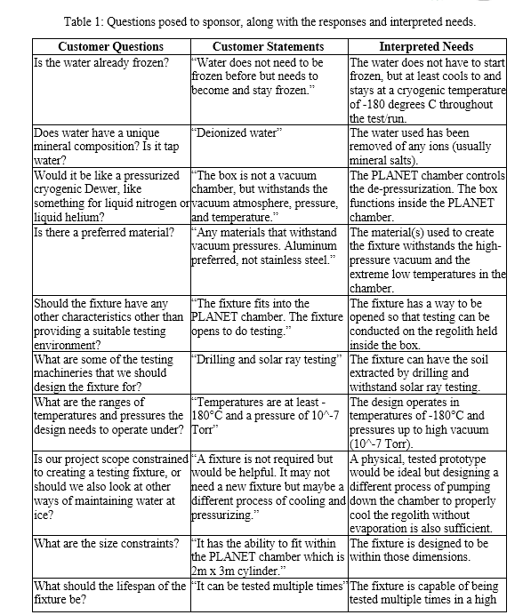
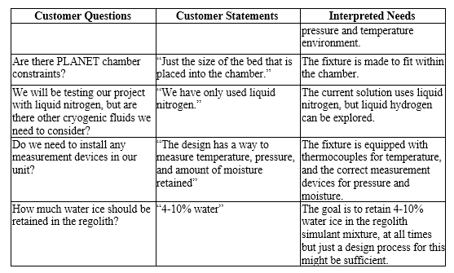
Customer Needs

Slide 112
Megan Reid
Key Goals
Thermal Maintenance
Notes:
Cool regolith simulant bed before and during high vacuum (10^-7 Torr)
Regolith needs to be cooled to a low enough temperature before depressurization so that water ice doesn’t sublimate
Needs to fit within the NASA PLANET Chamber

Slide 113
Megan Reid
Key Goals
Thermal Maintenance
Regolith
Notes:
Cool regolith simulant bed before and during high vacuum (10^-7 Torr)
Regolith needs to be cooled to a low enough temperature before depressurization so that water ice doesn’t sublimate
Needs to fit within the NASA PLANET Chamber

Slide 114
Megan Reid
Key Goals
Thermal Maintenance
Regolith
PLANET
Chamber
Notes:
Cool regolith simulant bed before and during high vacuum (10^-7 Torr)
Regolith needs to be cooled to a low enough temperature before depressurization so that water ice doesn’t sublimate
Needs to fit within the NASA PLANET Chamber

Slide 115
Megan Reid
Key Goals
Thermal Maintenance
Regolith
PLANET
Chamber
High Vacuum
Notes:
Cool regolith simulant bed before and during high vacuum (10^-7 Torr)
Regolith needs to be cooled to a low enough temperature before depressurization so that water ice doesn’t sublimate
Needs to fit within the NASA PLANET Chamber

Slide 116
Megan Reid
Assumptions
Materials provided for final testing at NASA - MSFC
Operating Conditions
PLANET Chamber
Humidity is controlled at 65%
Instrumentation
Cooling with Cryogenic Liquids
Regolith Simulant
No extreme conditions
Notes:
Following Materials will supplied:
Liquid Nitrogen
Regolith Simulant
Vacuum Chamber
Instrumentation
Final testing conducted at Marshall Space Flight Center
Humidity is at 65% (controlled)

Slide 117

Markets & Stakeholders
Megan Reid
NASA - MSFC
SpaceX
Boeing
Blue Origin
Other Private Aerospace Companies
Notes:
Primary:
NASA
Secondary:
SpaceX, Boeing, or Blue Origin
Private aerospace companies developing extraction and excavation technologies

Slide 118
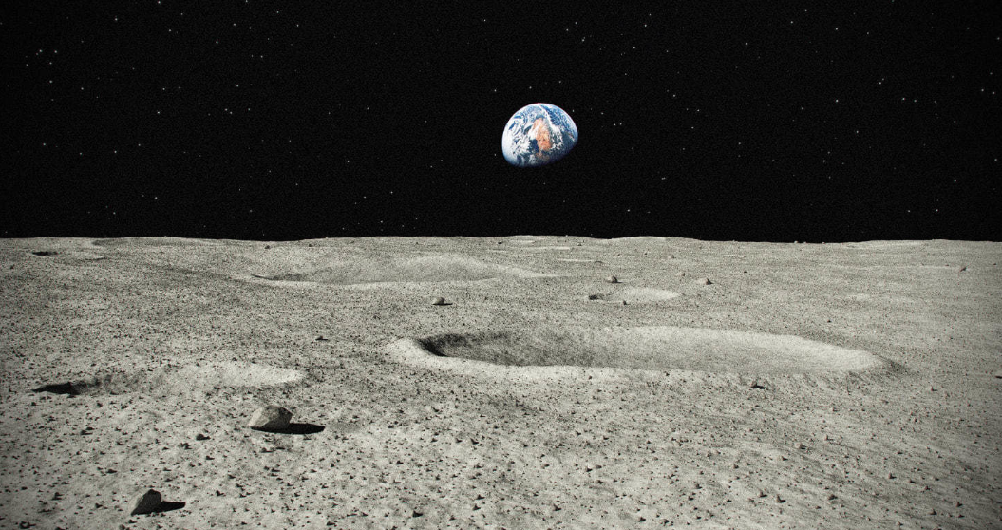



Targets and Metrics
Trent Walker
4-10%
1.33e-4 Pa – 1.33e-5 Pa
173.15 K - 203.15 K
Notes:
Units are trash

Slide 119
Customer Needs
Luke Leibkuchler
Water
Phase
Uniform
Properties
Monitor
Properties
PLANET
Chamber
Pressure
Maintain water in the solid phase
Water will be in the regolith

Slide 120
Customer Needs
Luke Leibkuchler
Water
Phase
Uniform
Properties
Monitor
Properties
PLANET
Chamber
Pressure
Maintain water in the solid phase
Water will be in the regolith
Operates in atmospheric to high vacuum pressure
Mimics space environment

Slide 121
Customer Needs
Luke Leibkuchler
Water
Phase
Uniform
Properties
Monitor
Properties
PLANET
Chamber
Pressure
Maintain water in the solid phase
Water will be in the regolith
Operates in atmospheric to high vacuum pressure
Mimics space environment
Reaches desired moisture, pressure, and temperature in regolith

Slide 122
Customer Needs
Luke Leibkuchler
Water
Phase
Uniform
Properties
Monitor
Properties
PLANET
Chamber
Pressure
Maintain water in the solid phase
Water will be in the regolith
Operates in atmospheric to high vacuum pressure
Mimics space environment
Reaches desired moisture, pressure, and temperature in regolith
Ability to monitor moisture, pressure, and temperature in regolith

Slide 123
Customer Needs
Luke Leibkuchler
Water
Phase
Uniform
Properties
Monitor
Properties
PLANET
Chamber
Pressure
Maintain water in the solid phase
Water will be in the regolith
Operates in atmospheric to high vacuum pressure
Mimics space environment
Reaches desired moisture, pressure, and temperature in regolith
Ability to monitor moisture, pressure, and temperature in regolith
Fits into and is compatible with the PLANET Chamber

Slide 124
Functional Decomposition
Luke Leibkuchler
NASA Cooling Fixture
Thermal
Controls
Structure

Slide 125
Functional Decomposition
Luke Leibkuchler
NASA Cooling Fixture
Thermal
Controls
Structure
Pre Pump Down
Post Pump Down
Control Water Composition
Cool Entire Mass to Cryogenic Temperatures
Pump to High Vacuum

Slide 126
Functional Decomposition
Luke Leibkuchler
NASA Cooling Fixture
Thermal
Controls
Structure
User Interface
Motion
Data Acquisition
Display Properties
Open Hatch

Slide 127
Functional Decomposition
Luke Leibkuchler
NASA Cooling Fixture
Thermal
Controls
Structure
Cool Entire Mass to Cryogenic Temperatures
User Interface
Motion
Data Acquisition
Display Properties
Open Hatch

Slide 128
Functional Decomposition
Luke Leibkuchler
NASA Cooling Fixture
Thermal
Controls
Structure
Withstand PLANET
Operate within PLANET
Protect Electrical Components
Structural Integrity at Extreme Conditions
Move In and Out of Chamber
Fit Within Dimensions

Slide 129
Functional Decomposition
Luke Leibkuchler
NASA Cooling Fixture
Thermal
Controls
Structure
Controls
Lid
Withstand PLANET
Operate within PLANET
Protect Electrical Components
Structural Integrity at Extreme Conditions
Move In and Out of Chamber
Fit Within Dimensions

Slide 130






Future Work
Luke Leibkuchler
Target &
Metrics
Prototypes
Risk
Assessment
Create prototypes of high-fidelity concepts to aid in selection
Set targets and metrics for system
Perform risk assessment
Generate 100 ideas for solution that fits needs and targets
Select final concept
Create bill of materials
Concept
Generation
Concept
Selection
Bill of
Materials
Meet with advising team
Notes:
Targets and Metrics
Concept Generation and Selection
Prototypes
Biweekly Sponsor Meetings
Risk Assessment
Bill of Materials
Spring Project Plan

Slide 131
Preliminary Drip Lid CAD
Top View - Closed
Top View - Open

Slide 132
Preliminary Drip Lid CAD
Side View - Exploded
Bottom View - Exploded

Slide 133
Thank You!
Notes:
Targets and Metrics
Concept Generation and Selection
Prototypes
Biweekly Sponsor Meetings
Risk Assessment
Bill of Materials
Spring Project Plan

Slide 134
This is 10-point
This is 15–point Times
This is 20–point
This is 25–point
This is 30–point
This is 35–point
This is 40–point
This is 50–point
This is 60–point
This is 72–point
Notes:
Use at least 20-point font in Room A105, B134, and B136
Use at least 25-point font in Room B135

Slide 135
College of Engineering Color Palette
1 2 3 4
Pantone: PMS 195 C
RGB: 120, 47, 64
Hex: #782F40
CMYK:19, 90, 50, 55
1 2 3 4
Pantone: Black C
RGB: 0, 0, 0
Hex: #000000
CMYK:0, 0, 0, 100
Garnet
Black
1 2 3 4
RGB: 238, 118, 36
Hex: #EE7624
CMYK:2, 66, 99, 0
1 2 3 4
Pantone: PMS 000C
RGB: 255, 255, 255
Hex: #FFFFFF
CMYK: 0, 0, 0, 0
Fang
Orange
White
Notes:
Avoid 75% Black in B135

Slide 136
Accent Color Palette
1 2 3 4
RGB: 0, 59, 111
Hex: #003B6F
CMYK:
1 2 3 4
RGB: 0, 59, 111
Hex: #003B6F
CMYK:
1 2 3 4
RGB: 251, 236, 93
Hex: #FBEC5D
CMYK:
1 2 3 4
RGB: 219, 215, 210
Hex: #DBD7D2
CMYK:
1 2 3 4
RGB: 251, 236, 93
Hex: #FBEC5D
CMYK:
1 2 3 4
RGB: 219, 215, 210
Hex: #DBD7D2
CMYK:
Tardis Blue
Tardis Blue
Corn
Timberwolf
Corn
Timberwolf
1 2 3 4
RGB: 206, 0, 88
Hex: #CE0058
CMYK: 0, 100, 43, 12
1 2 3 4
RGB: 206, 0, 88
Hex: #CE0058
CMYK: 0, 100, 43, 12
1 2 3 4
RGB: 104, 40, 96
Hex: #682860
CMYK:
1 2 3 4
RGB: 220, 220, 220
Hex: #DCDCDC
CMYK:
Rubine Red
Rubine Red
Imperial
Gainsboro
1 2 3 4
RGB: 72, 146, 155
Hex: #48929b
CMYK:
1 2 3 4
RGB: 64, 224, 208
Hex: #40E0D0
CMYK:
1 2 3 4
RGB: 255, 139, 0
Hex: #FF8B00
CMYK:
Asagi-iro
Turquoise
American Orange
Notes:
Remove American orange add hyperlink grey
Make corn the last for b135
All work in 134 imperial move later
Tardis doesn’t work in b136

Slide 137
F7AB19
D67F15
EE7624
D64615
F73119
Analogous
https://color.adobe.com/create/color-wheel
6E3610
F0A16C
EE7624
6E4931
BASB1C
Monochromatic
A14508
4BED3B
EE7624
250CED
2010A1
Triad
A1470C
FF8C40
EE7624
0098A1
24E2ED
Complementary
28A164
2FED8D
EE7624
0848A1
1871ED
Split Complementary
EDAC2F
3BED93
EE7624
0C6AED
ED2F18
Double Split Complementary
ED660C
C7ED3B
EE7624
0CE1ED
A418ED
Square
BA7E09
87724A
EE7624
60EFCF
09BA61
Compound
AD551A
6E3610
EE7624
FA7625
D46820
Shades
Notes:
These are the variants that work well with Fang Orange. The bolded items show well on the projectors.

Slide 138
85412D
8F3831
782f40
8F3176
792D85
Analogous
https://color.adobe.com/create/color-wheel
C44D69
8E626D
782F40
C48796
451B25
Monochromatic
C43959
78743B
782F40
236178
43A2C4
Triad
C43959
C46078
782F40
25C43D
2F783A
Complementary
93C460
577835
782F40
39C49D
297861
Split Complementary
784435
5A783B
782F40
237860
6E2978
Double Split Complementary
782337
78683b
782F40
237830
293978
Square
AB4D32
DEBAAF
782F40
5D8555
70AB32
Compound
38161E
C44D69
782F40
853447
5E2532
Shades

Slide 139
A105
A105
B135 Stage Left
B135 Stage Right
B136
B134, A105
B135

